Slide 1
Insurance premium prediction
By
Satya Vijay Nerurkar

Slide 2
Objective :
Development of a predictive model that should able to predict the amount of the premium for health insurance which will give an estimate of how much a person needs on their individual health situation.
Benefits :
Gets an idea about how much amount is required annually according to their own health status.
This can help a person in focusing more on the health aspect of insurance.
Help in giving premium of health insurance.

Slide 3
Data Sharing Agreement :
Column names
Column data type
Numerical Columns names
Categorical Columns name
Target columns name
Domain Values of categorical columns

Slide 4
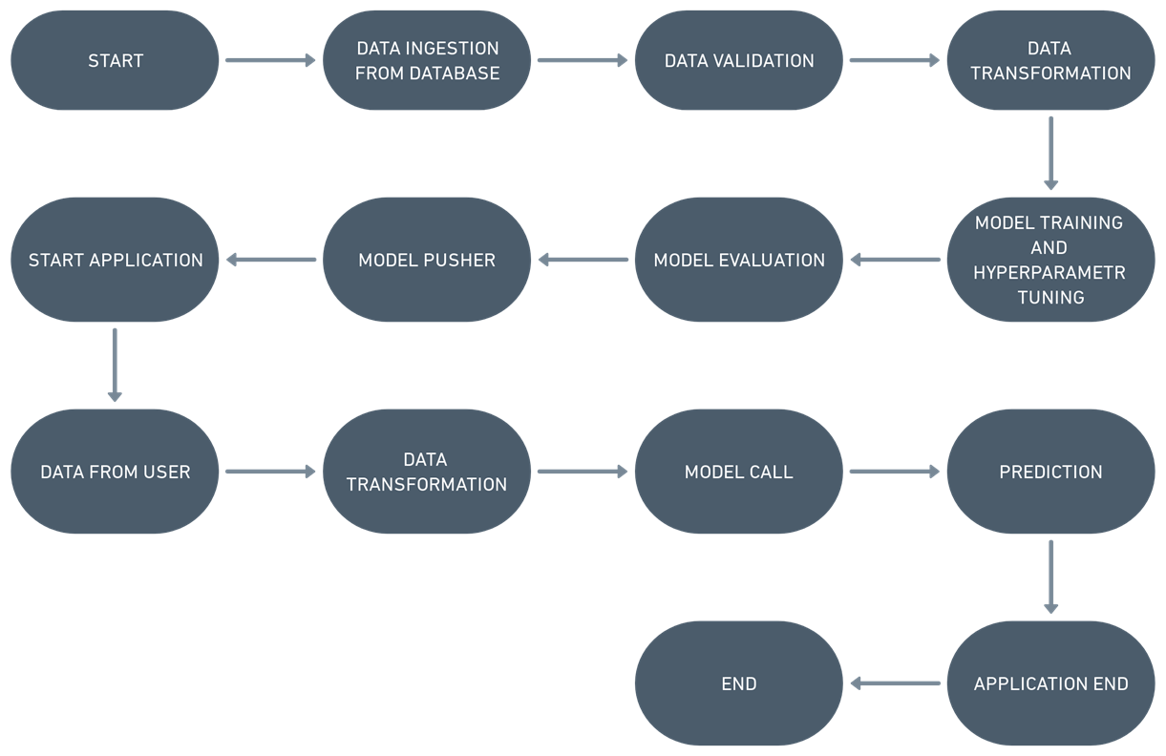
Architecture

Slide 5
Data Ingestion and Data validation
The dataset was taken from the Kaggle competition page and saved into the MongoDB database.
The accumulated data from the DB is exported in CSV format for data validation.
The data type of columns – Validating the data type of the columns if wrong, then it was corrected.
Null values in columns – Validating the column in the dataset have null values or missing information.
Numerical columns – Validating the names of columns that have numerical values.
Categorical columns – Validating the names of columns that have categorical values.
Domain values of categorical columns – Validating the categories that are present in each categorical column.
Target column – Validating the name of the target column.

Slide 6
Data Transformation
Data Pre-processing:
Performing EDA to get insights of the data like identifying distribution, outliers, etc.
Check any null values present in the dataset. If present then imputes those null values.
Encode the categorical features/columns.
Perform Standard Scalar to scale down values.
All the pre-processing steps were kept in the pipeline and saved as an object file.

Slide 7
Model Training ,Evaluation and Selection
After pre-processing in model training, we find the best model for premium prediction.
We train the different models using a training set by using multiple regression algorithms like Linear Regression, Random Forest, Gradient Boosting, and Grid Search CV for best parameters.
Then we test each model with a test set, we will find the accuracy of train and test predictions using evaluation metrics like RMSE (Root mean squared error) and R2_score (R-squared).
The model which gives close train and test accuracy with the least RMSE train test difference is chosen.
The object file of the model along with preprocessing technique was saved and combined for developing API for the prediction of premium.

Slide 8
Predictions
The user inputs the required details over the API and submits them.
At the backend the combined saved object file is called which does the required transformation as well as the prediction using the input data.
The outcome of the prediction along with the user inputs is displayed over the API for the user.

Slide 9
Q & A
Q1) What is the source data?
The source of the data is Kaggle. The data is stored in the MongoDB database.
Q2) What was the type of data?
The data was a combination of categorical and numerical values.
Q3) What’s the complete flow you followed in this project?
Refer to the 5th slide for a better understanding

Slide 10
Q4) What techniques were you using for data pre-processing?
Visualizing relation of independent variables with each other and dependent variable.
Checking distribution of Continuous variables.
Checking any null values present in the dataset.
Converting categorical data into numeric values.
Scaling the data.
Q 5) How logs are managed?
We are using logs at each start and end of the components process and where there is any important import or export of file happens inside the pipeline.

Slide 11
Q6) How training was done or what models were used?
Before training the model the dataset is divided into the training set and testing/validation set.
The scaling was performed on the training and testing set.
The categorical columns were converted into numeric values.
We train the different models using a training set by using multiple regression algorithms like Linear Regression, Random Forest, Gradient Boosting, and Grid Search CV for best parameters.
Then we test each model with a test set, we will find the accuracy of train and test predictions using evaluation metrics like RMSE (Root mean squared error) and r2_score (R-squared).
The model which gives close train and test accuracy with the least RMSE train test difference is chosen.

Slide 12
Q7) How prediction was done?
On the basis of the trained model, the prediction was performed. We also created an API interface for estimating the cost of premiums on the basis of personal health information/status.
Q8) What are the different stages of deployment?
When the code is ready we store all the files in GitHub.
With the help of GitHub actions, we create the workflow for creating a Docker image for the model as well as pushing it into the AWS cloud platform.
When the code is pushed to the main branch the workflow gets triggered and the model gets deployed into AWS.
Q 9) How logs are managed?
We are using logs at each start and end of the components process and where there is any important import or export of file happens inside the pipeline.

Slide 13
Thank you!

